Slide 1
Tech-Fin for FinTech

Slide 2
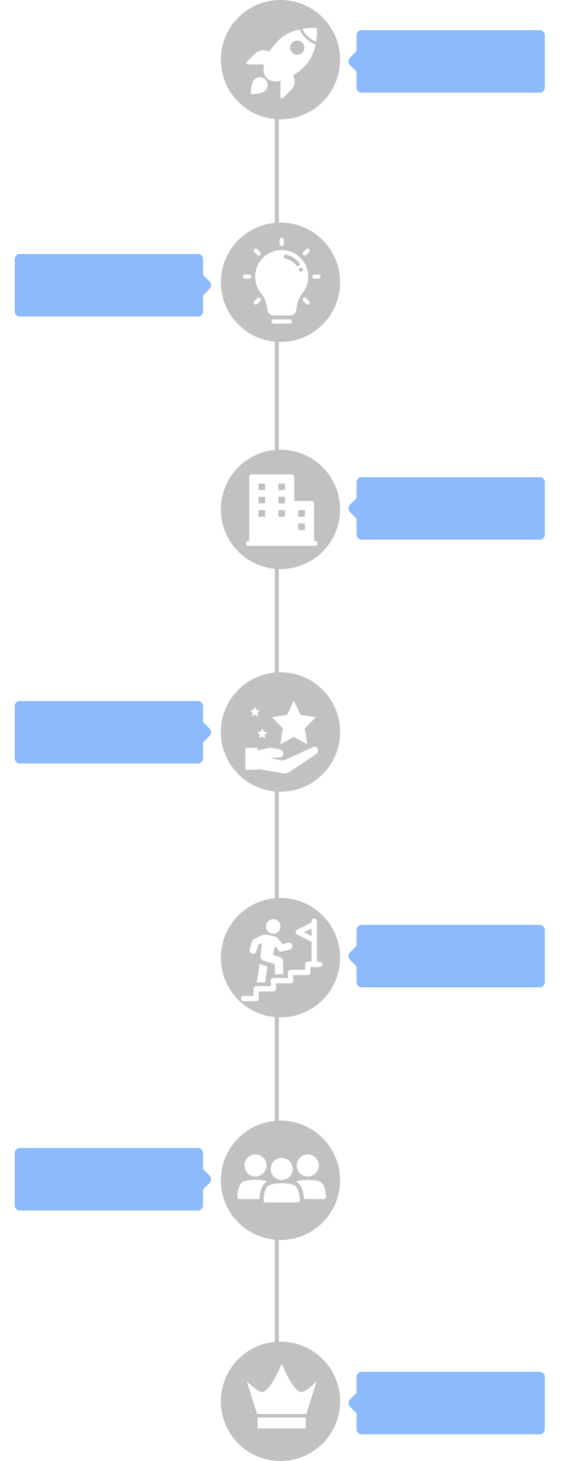
The Company
Incorporation
2011
We build cutting edge technology for Banks and Financial Institutions to help them scale. Based in DC Metro area, we are a growing company with over 500 Customers ranging from Small Lenders to Large Banks & Financial Institutions across Asia and Africa.
SynapOne team is diversely skilled and works very closely with our customers that consult, develop and implement solutions for their business growth.
2016
Innovation
Growth
2018
2020
Impact
Emerging Leader
2021
2022
Resilience
Scale & Beyond
2023

Slide 3
Our Presence
India – SE Asia – Africa
500+
Customers
$1B+
Loans Served
80+
Enterprise Customers

Slide 4
Our Customers
Our 500+ customers are our motivation

Slide 5
Lending Technology Landscape
Lenders are losing business to Fin-Techs and new-age Digital Lenders that can provide Quick, Contactless and Instant Credit.
Challenges
Out-Dated Systems
Fragmented Ecosystem
Disparate Systems
Regular Downtimes
Delayed Response Time
Huge Turn Around Time
Inhibited Innovation

Slide 6
Unified
Lending
Platform
LENDING SOLUTION
COMPREHENSIVE AND COMPOSABLE TECHNOLOGY
FOR LOANS ORIGINATION, MANAGEMENT AND COLLECTIONS

Slide 7
The Technology
Bank-Grade Network Security
AWS
Public Cloud
Enterprise
Private Cloud
AWS
Security Groups
SynapOne Enterprise Platform is a 100% proprietary Unified Lending Technology platform that has been built Cloud-first, offers Bank-grade Information Security & is built on well-documented REST API, following Open API standards for ease of Integration with other systems.

Slide 8
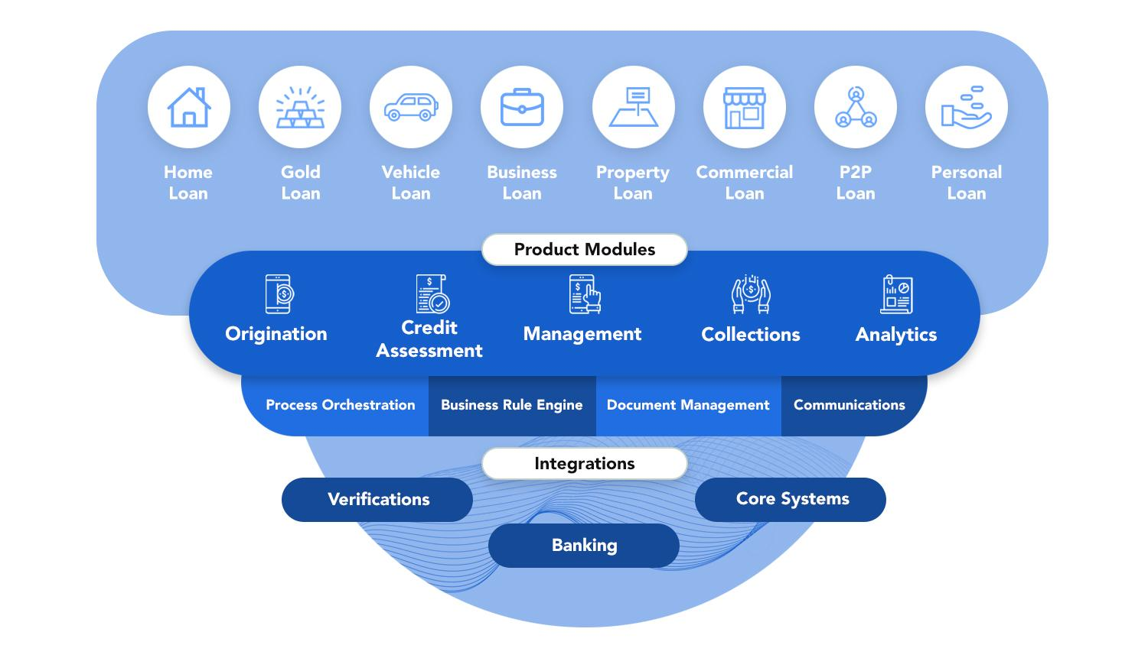
Product Overview

Slide 9
Modules
Loan Management System
Collections &
Recovery
System
Loan Origination System
Mobility for Sales & Collections

Slide 10
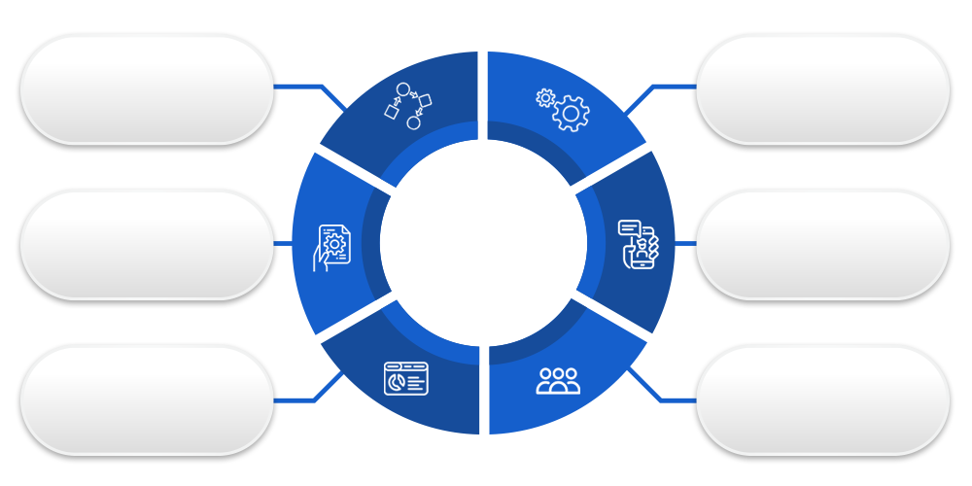
UNO ETOA JAOM FROAN MODERN CLEAN CREATIVE DESIGN.
Cross-Module Configurability
Workflows
Business Rules
CORE
PLATFORM
Document
Management
Communications
SMS/Email/Letters
Scorecards
User Access &
Role Management

Slide 11
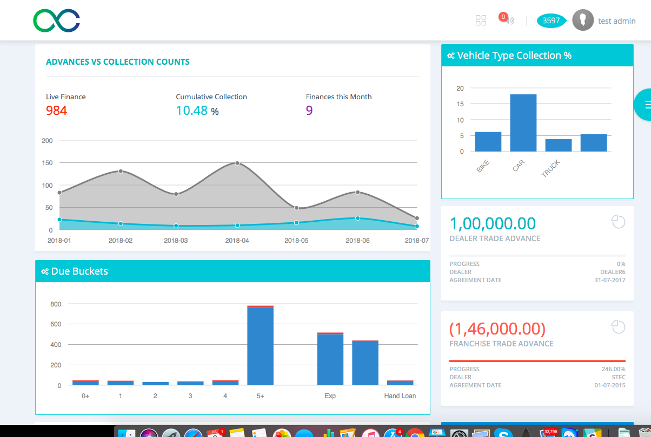
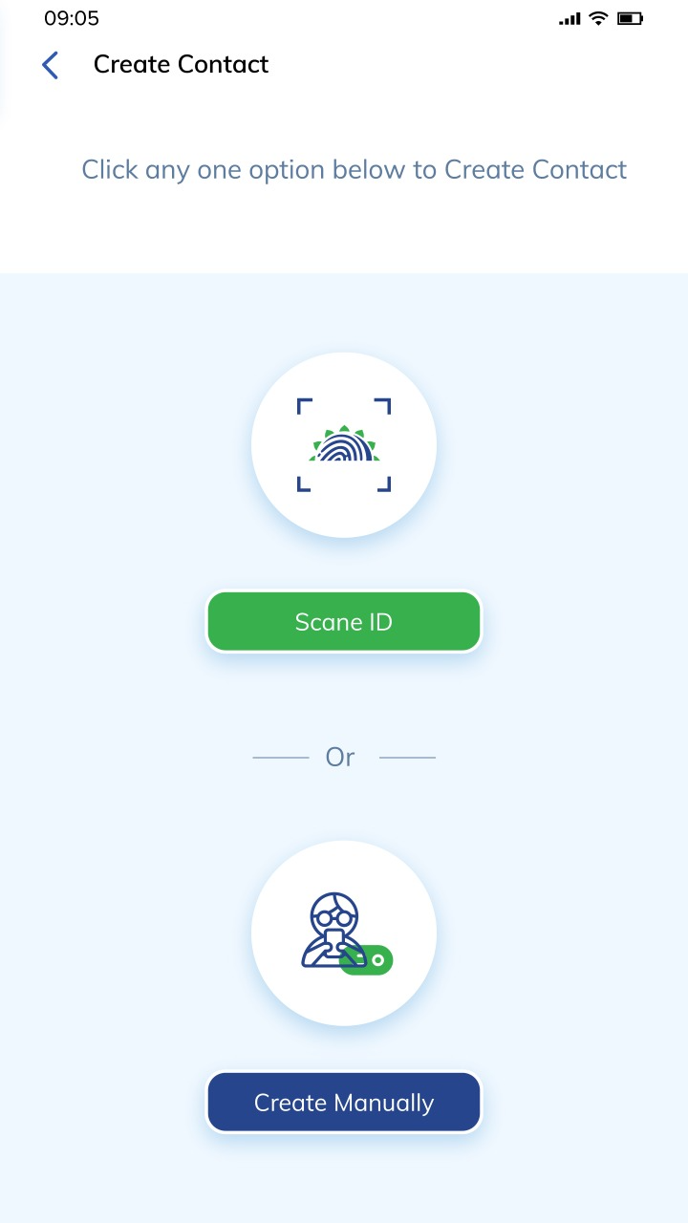
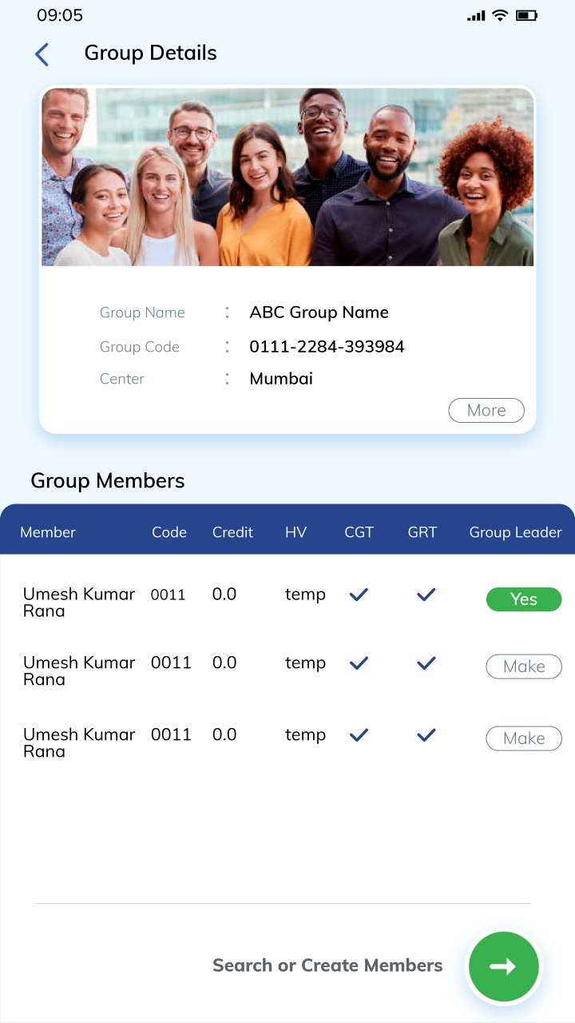
The ACE Advantage
Extremely Configurable
User Friendly Interface
Realize ROI sooner
Latest Tech-Stack
Integration Ready
Hyper Scalable
No-Code
Approach
Cloud-
First
Quick
Go-to-Market
Bank-Grade
Security
Dedicated
Support
Always
Updated
OMNI-CHANNEL SOLUTION

Slide 12
Loan Origination
Enquiry
Lead/Loan Application
Credit Decisioning Engine
Configurable Business Rules
Configurable Workflows
Scorecard(s) Configurability
Document Management
Communications & Notifications
TAT Management
Sales Field Agent Mobile App
Geotagging
Role-based Dashboards

Slide 13
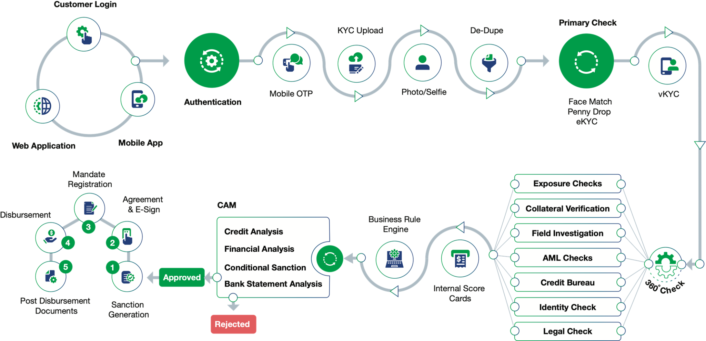
A Comprehensive Origination Journey

Slide 14
Loan Servicing
Disbursals
PDC / ACH / Mandate Management
Loan Servicing
Collateral Management
Notices & Letters
Pre-payments / Part-payments
Moratorium / Amendments
Loan Swap
Settlement
Write-off
Account Ledgers

Slide 15
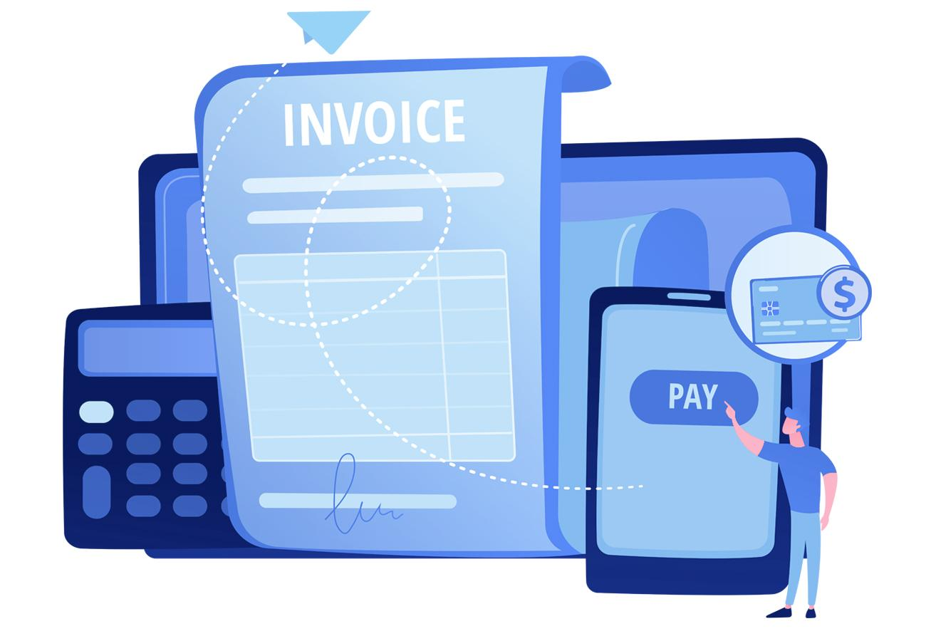
Collections
Promise-To-Pay Management
Collection Agent Mobile App
Delinquency Ageing & Processing
Configurable Buckets
Automatic Bucket Movement
Cash Collections
Click-to-pay Link
Repossession Module
Legal Module
Comprehensive Reports

Slide 16
Mobility Solutions
Android & iOS Native Mobile Applications for:
Origination – Field On-boarding & Investigations
Collections – Field Collections & Recovery
Specialized Group Loans – Field Operations
Mobile Apps are tightly Integrated with Loan Origination & Collections modules respectively

Slide 17
Connect-to-Customer
Web | App | Chat
Easy Integrations with all Customer channels
Onboarding with Instant KYC Validation
Give Soft approval with minimum Documents
Accept Loan Applications
Check Loan Application Status
Loans Dashboard
Repayment Schedule(s)
Due Reminders

Slide 18
Reports
A wide variety of Reports are available on the ACE platform, including but not limited to:
Business Reports
SMS Reports
Document Reports
Collections Reports
Process Reports
Compliance Reports
Audit Reports
Accounting Reports

Slide 19
Case Study – Growth
Case Study - Customer is a Leading NBFC in Vehicle Loans Domain
M2M
Steady Growth
NPA
Reduction
500
Users
150
Branches
From 2,000 - 55,000 Loans

Slide 20
Thank you!

